Slide 1
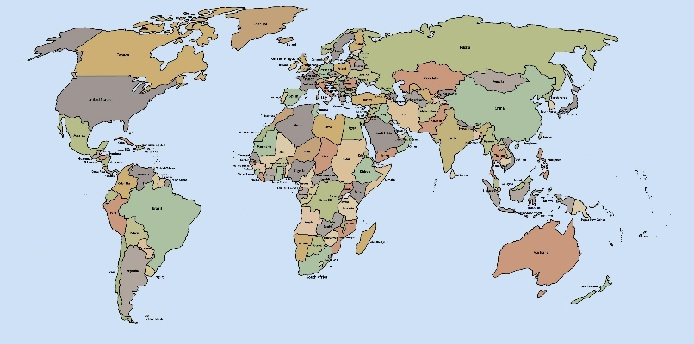
Miramar High School International Baccalaureate Program
High school education on an international standard

Slide 2
The IB Program Mission Statement
The International Baccalaureate aims to develop inquiring, knowledgeable, and caring young people who help to create a better and more peaceful world through intercultural understanding and respect.
To this end the organization works with schools, governments, and international organizations to develop challenging programmes of international education and rigorous assessment.
These programmes encourage students across the world to become active, compassionate, and lifelong learners who understand that other people, with their differences, can also be right.

Slide 3
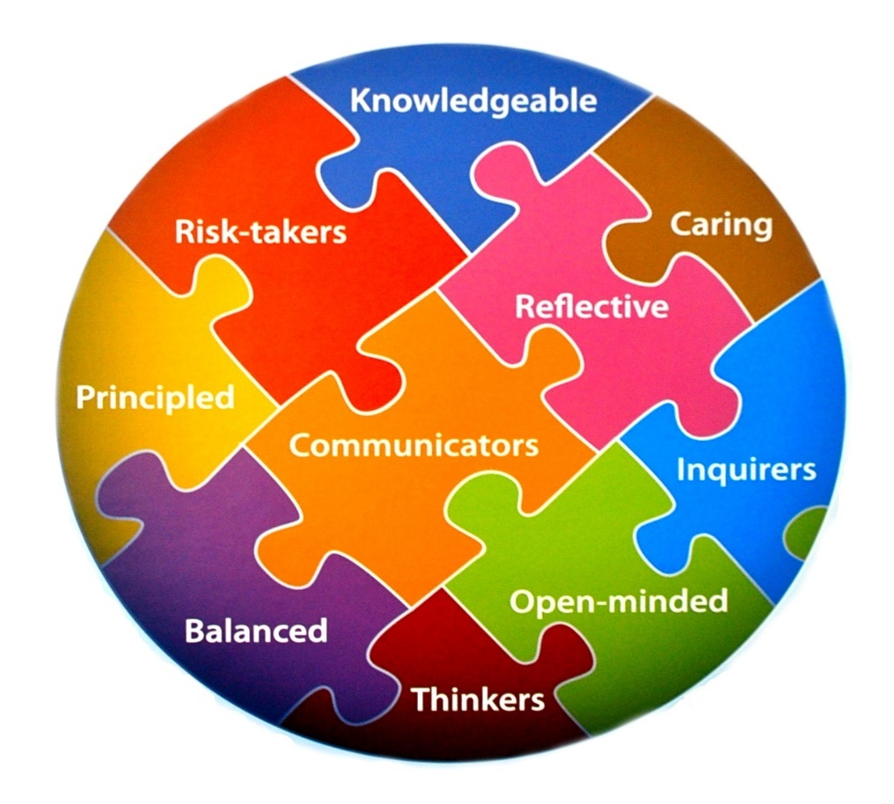
IB Learner Profile
IB learners strive to be:
Inquirers
Knowledgeable
Thinkers
Communicators
Principled
Open-minded
Caring
Risk-takers
Balanced
Reflective

Slide 4
The IB Student

Slide 5
IB Students are Lifelong Learners
Miramar IB graduates attend some of the finest universities in the country.
Miramar IB graduates have gone on to study medicine, law, engineering, global science, politics, and many other professions.

Slide 6
IB Hexagon

Slide 7
Miramar’s IB Curriculum

Slide 8
Miramar Program Highlights
Miramar IB students earned over 6 million dollars in scholarship money.
IB students averaged 30 college credits earned in high school
IB teachers at Miramar High School are some of the most qualified and talented in the school district
The IB program at Miramar is the only IB school in the district with a waiting list

Slide 9
How Colleges View IB
“IB is well known to us for excellent preparations. Success in an IB programme correlates well with success at Harvard. We are always pleased to see the credentials of the IB Diploma Programme on the transcript”
Marilyn McGrath lewis, Director of Undergraduate Admission, Harvard University
“Send us prepared students a la IB…It is the best high school prep curriculum an American School can offer”
-Marilee Jones, Former Director of Undergraduate Admission, Massachusetts Institute of Technology

Slide 10
Contact us
Magnet Coordinator: Mr. Lamb
John.lamb@browardschools.com
Miramar High School
(754) 323-1350

